Slide 1
ARL Notification List Final Project
Heather Anderson
Kevin Avila
Alex Cheng

Slide 2
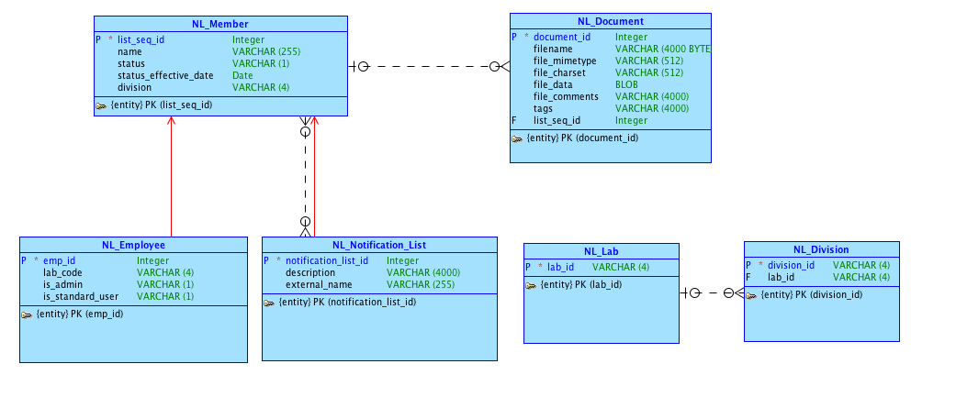
Conceptual Model

Slide 3
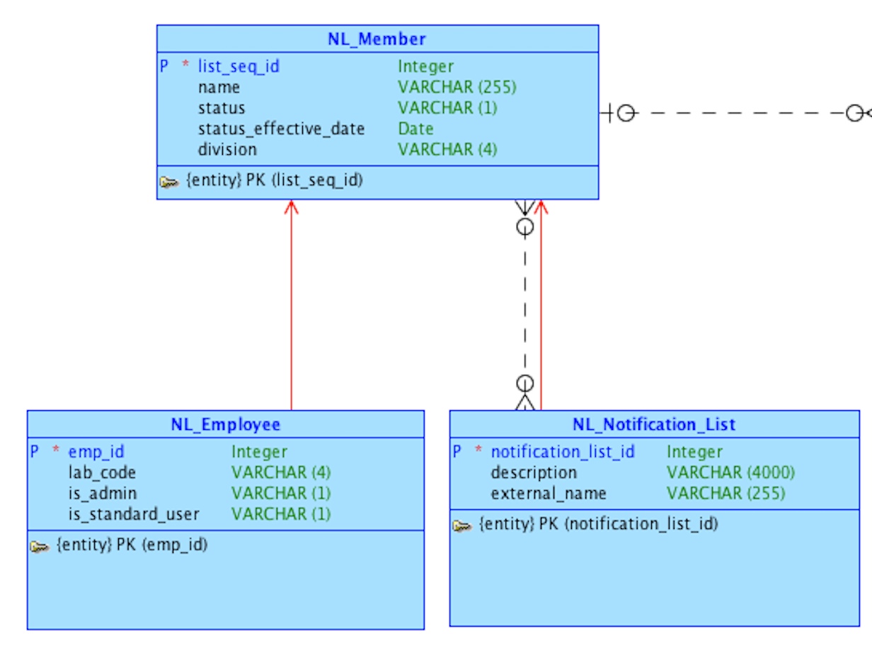
Conceptual Model – Closer Look

Slide 4
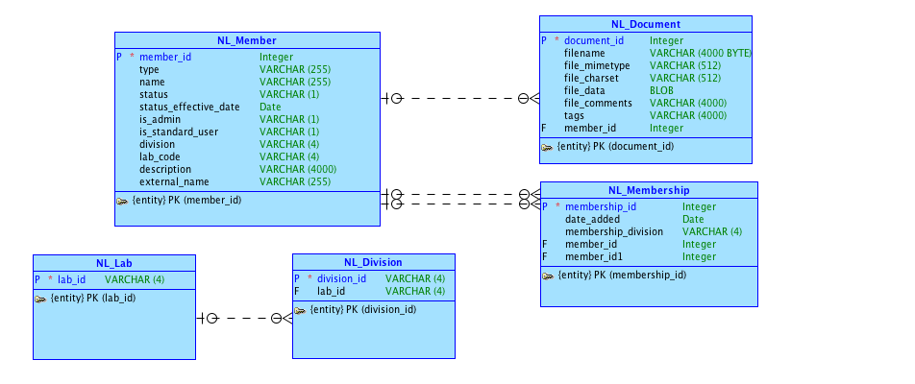
Logical Model

Slide 5
DDL4 Views
Notification List
Admin Employee
Standard Employee
Employee (Other Employee)

Slide 6
Implementation Details
1. Permissions
Added a “Log In” region to the home page
Added item containing a select list of all employees based on member_id (in case of duplicate names)
Submit button saves user’s choice

Slide 7
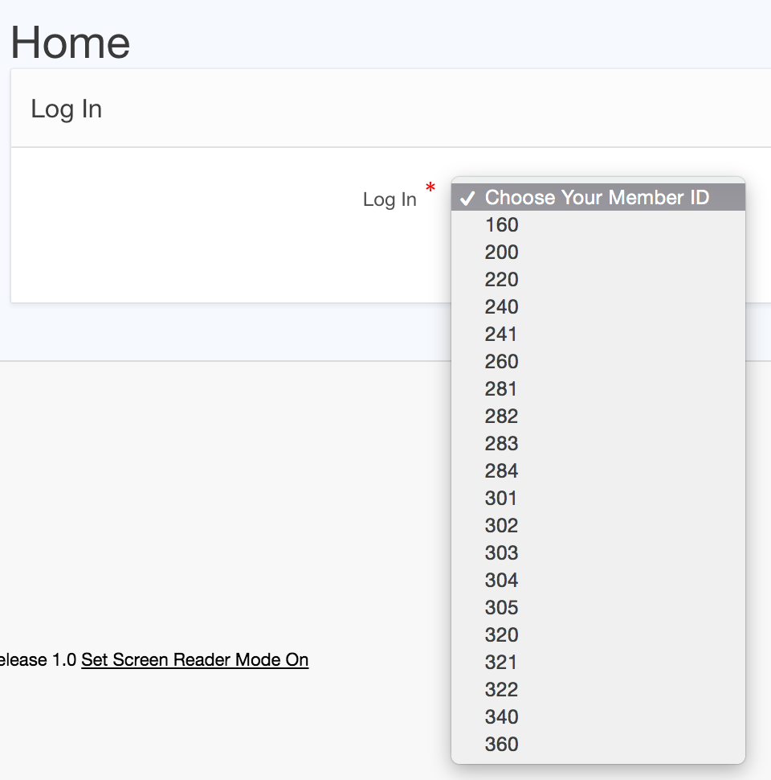
Permissions

Slide 8
Permissions cont.
Added a condition to all of the “create” buttons for new lists
Condition Type: Exists (SQL query returns at least one row)
SQL Expression:
select *
from NL_MEMBER
where member_id = :P1_MEMBER_ID and is_admin=‘Y’
:P1_MEMBER_ID → member_id from Log In screen
Now, can only admins can creates lists

Slide 9
Permissions cont.
Standard users can only edit lists with their lab code. List of values:
declare
emp_type varchar2(255);
begin
select type
into emp_type
from NL_MEMBER where member_id = :P1_MEMBER_ID;
if emp_type = 'Standard Employee' then
RETURN
'select name as d,
member_id as r
from NL_MEMBER
where type=''Notification List''and (select lab_code
from NL_Member
where member_id = :P1_MEMBER_ID) = lab_code
order by 1';
ELSE
RETURN
'select name as d,
member_id as r
from NL_MEMBER
where type=''Notification List''';
END IF;
END;

Slide 10
Permissions cont.
Using the same strategy, we did the following:
Inactive employees and “Other Employees” cannot edit lists at all
Admins can make all changes to lists
Inactive employees/lists cannot be added to lists

Slide 11
Implementation Details
2. Adding to a Notification List
Created a “Membership” page
To add to a list, you can create a new membership
Select a Notification List and a Notification List Member to add to that list (could be either an Employee or another List)
“Create & Create Again” button

Slide 12
Link to Application
https://apex.oracle.com/pls/apex/f?p=94370:1:103145724631884

